Slide 1

AI training group
Weekly Report
Nguyen khai phu – SEP 15 2023

Slide 2
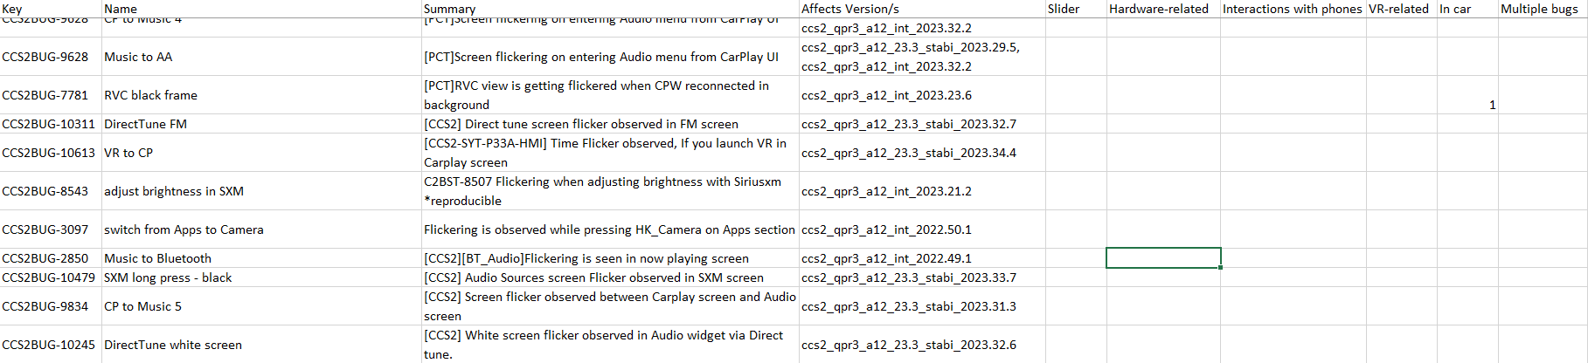
Collect data
ISP008 foundation
219 issues – 324 videos
2
CISP-1352-A21 - ISP-DOC-STYLETYPE-Templates © Robert Bosch GmbH 2016. All rights reserved, also regarding any disposal, exploitation, reproduction, editing, distribution, as well as in the event of applications for industrial property rights.

Slide 3
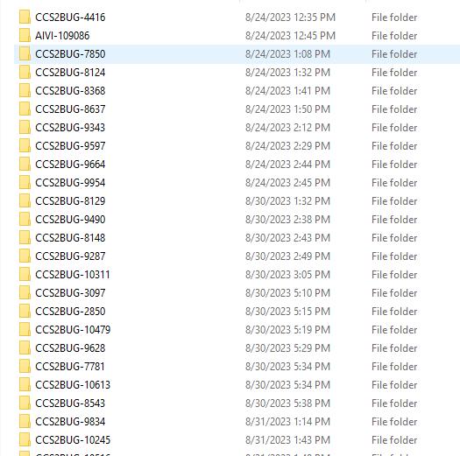
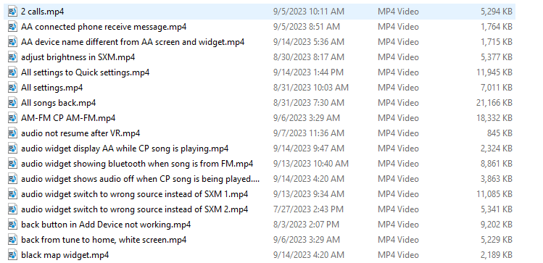
Collect data
ISP008 foundation
2
CISP-1352-A21 - ISP-DOC-STYLETYPE-Templates © Robert Bosch GmbH 2016. All rights reserved, also regarding any disposal, exploitation, reproduction, editing, distribution, as well as in the event of applications for industrial property rights.

Slide 4
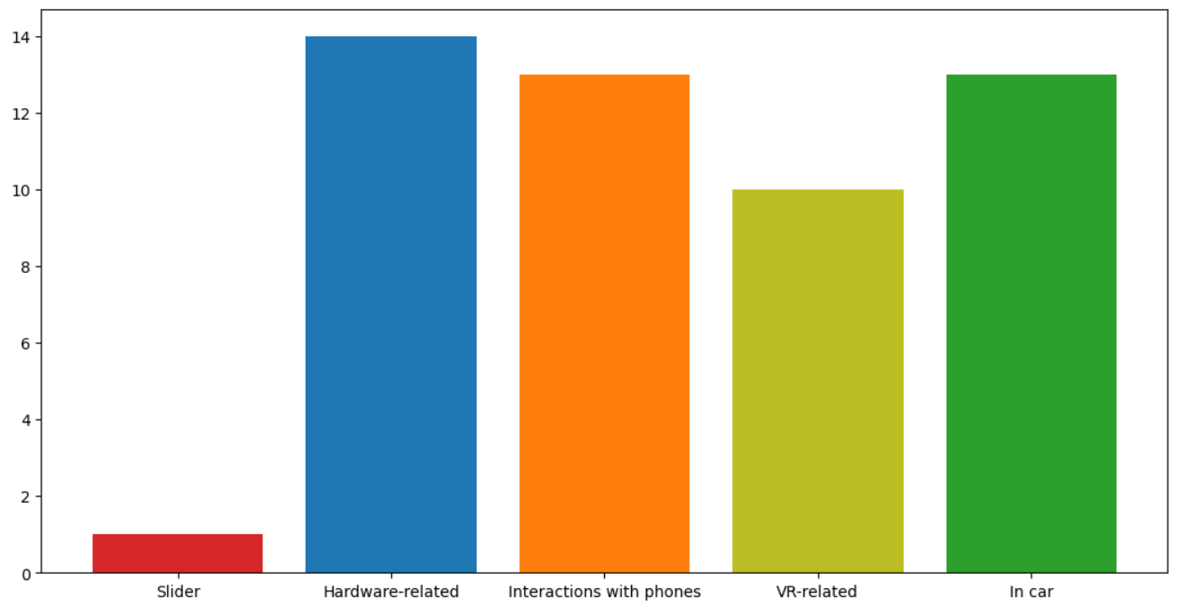
Collect data
ISP008 foundation
2
CISP-1352-A21 - ISP-DOC-STYLETYPE-Templates © Robert Bosch GmbH 2016. All rights reserved, also regarding any disposal, exploitation, reproduction, editing, distribution, as well as in the event of applications for industrial property rights.

